Slide 1


GUIDE FOR BLIND
Smart Blind Stick Using Arduino and Ultrasonic Sensor

Slide 2

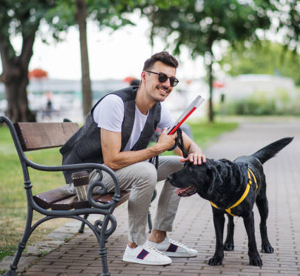
INTRODUCTION:
AIM :
The study focus on a simple method of detecting the obstacle and route by using an ultrasonic sensor that can detect a hole or stair with maximum range about 2 meter. As we can see Blind people is having their trouble to do their life routines because they can’t see even a single things.
This ultrasonic blind stick have a several feature that surely can help this blind people to navigate routes and detect an obstacle that surely can make their life routines easier.
The user just need to use the blind the normal blind stick , the different is , blind people can detect a hole or stair more faster and easily.

Slide 3

OUR AGENDA IS…
This project intends to make ease for the optically defected people as a guide.
To make them feel confident enough to do their works on their own.
To help them to be aware of their surroundings as equally as a normal person.
To make them feel safe and secure to move around while walking
Keywords: Arduino uno, Ultrasonic sensors, RF transmitter and receiver

Slide 4

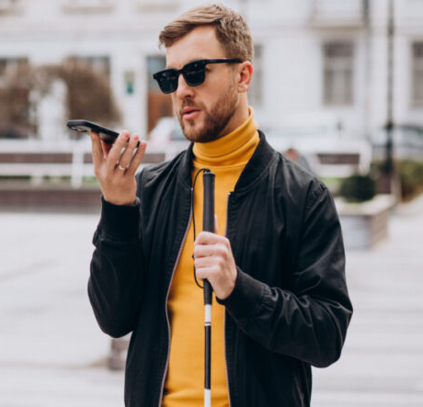
PROBLEM STATEMENT:
Blind peoples have to face many challenges in their life, one of them is finding their way on the streets.
Blind people can’t easily recognize obstacles or stairs while using normal blind stick. No safety features on the normal blind stick.
The blind traveler should depend on any other guide like blind cane , people information , trained dogs, etc. About the 90% of the worlds visually impaired live in developing countries.

Slide 5

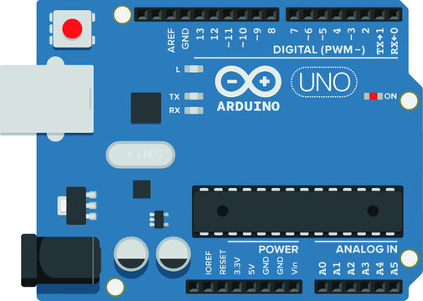
Required components:
Materials used for final invention build
  Arduino UNO
  USB cable for uploading the code
  Jumper wires
  Breadboard
  HC-SR04 ultrasonic sensor
  Buzzer
  LED with a 220 ohm resistor
  DC batteries

Slide 6

HOW DOES IT WORK…?
The Smart Blind Stick scans the path in front of it with the help of an HC SR04 Ultrasonic sensor.
Whenever the sensor detects any object in its path the buzzer starts beeping and also at the same time the LED turns on.
The blind person can hear the beeping of the buzzer and manage to change the way. In this way, the person can easily find his way without getting injured.
This smart stick works in the same way as the Ultrasonic range finder did. You can also see the real-time values of the distance in cm on the Arduino serial monitor.

Slide 7
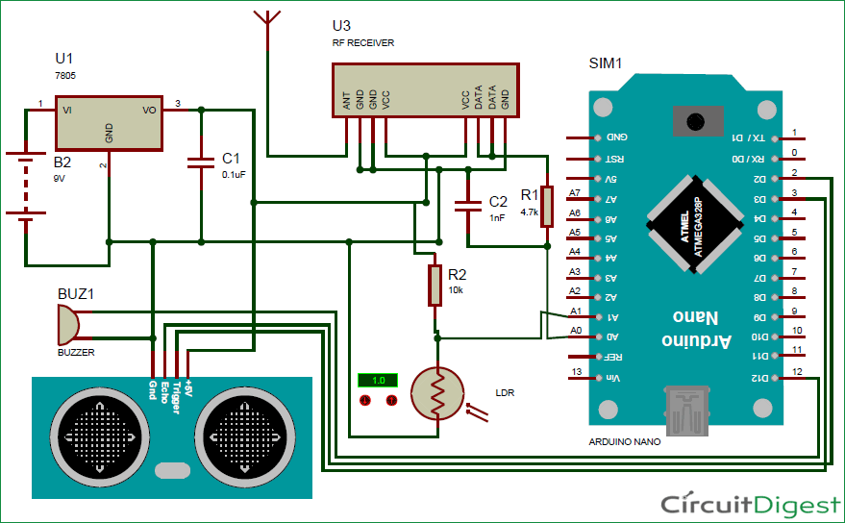
CIRCUIT DIAGRAM

Slide 8
TIME LINE:
PROBLEM
IDENTIFICATION
ARDUINO
CODING
FINAL SUBMISSION
JULY 2ND WEEK
AUG 1st WEEK
JUNE 3rd WEEK
JULY 3rd WEEK
AUG 1st WEEK
HARDWARE
ANALYSIS
TESTING

Slide 9
REFERENCES
https://maxbotix.com/blogs/blog/how-ultrasonic-sensors-work#:~:text=An%20ultrasonic%20sensor%20is%20an,information%20about%20an%20object's%20proximity.
https://www.arduino.cc/
https://techatronic.com/smart-blind-stick-using-arduino-and-ultrasonic-sensor/

Slide 10

Team members:
Chollangi Prasanth (21BCE9339)
Mokara Hemanth kumar (21BCE9109)
Marudi Anjana devi (21BCE9061)
Allada Manasa (21BCE9087)
Neeli Subhash (21BCE9549)
Bylapudi Lahari (21BCE9969)
Guided by:
Prof: Phani kumar meduri

Slide 11
THANK YOU

